Slide 1
DSS Training Material
Database Manager Utility and System Manager Training Module
DMU and SM Module
NBI Secretariat

Slide 2
What you learn in this module?
This module Introduces you to
General definitions and concepts.
Database management using the Database manager utility (DMU).
Workspace management using the DMU
User management using the DMU.
System Manager basics
System Manager functionality

Slide 3
NBDSS Definitions and Concepts

Slide 4
NBDSS definitions and concepts
Database server: is a program that contains a collection of the DSS databases and provides database services to the DSS.
Database: is a collection of workspaces with identical structure plus a master template that contains tables related to user and workspace management.
Workspace: is a collection of tables residing within an area of a database. All workspaces contain the exact same set of tables; but with different data in the tables. Datasets in the DSS are organized in workspaces.

Slide 5
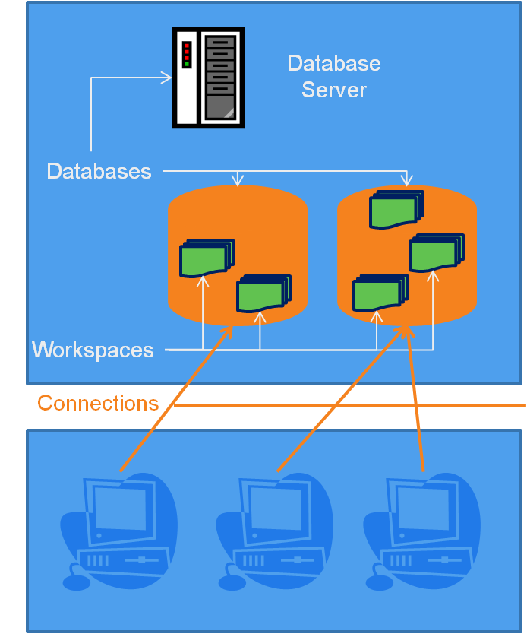
NBDSS definitions and concepts
Data Management in the DSS
The DSS data is stored in a database, which can have one or more workspace(s).
The DSS databases are stored on a database server. DSS users can make connection from their PCs (where the DSS software is installed) to access the DSS databases.
The database server and the DSS software can also co-exist on one PC.

Slide 6
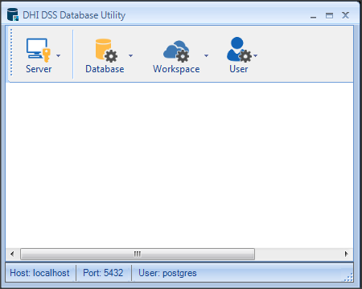
NBDSS definitions and concepts
What is the Database Manager Utility?
A stand alone tool that allows you to undertake the following:
Create a connection to the database server
Create, update, backup , restore and delete DSS databases
Create, import , export, remove and assign users to workspaces
Create, edit and remove DSS users

Slide 7
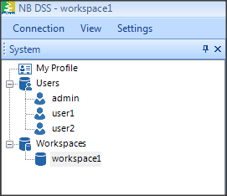
NBDSS definitions and concepts
What is the System manager?
It is part of the DSS user interface. It only offers a subset of the functions that are provided by the Database Manager Utility, namely:
Create and edit users
Create workspaces and assign users to workspaces
These functions are accessed through the DSS user interface

Slide 8
NBDSS definitions and concepts
What is the functionality overlap between the Database manager utility and the System manager?

Slide 9
Review Questions
Question 1: Databases can be managed using the 'System' manager. (True / False)
Question 2:The 'System' manager has a subset of the functionality of the Database manager utility (True / False)
Question 3: A DSS workspace can have one or more database. (True / False)
Question 4: The DSS can work with the PostgreSQL and Oracle database servers (True / False)

Slide 10
Database Management Using the DMU

Slide 11
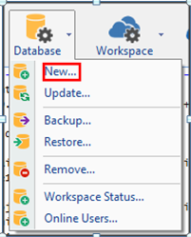
Database management using the DMU
Database management operations
The following operations can be undertaken using the Database Manager Utility:
Create a database
Update a database
Backup a database
Delete (or remove) a database

Slide 12
Exercises and Review Questions
Exercise 1: Creating a database
Exercise 2: Backup a database
Exercise 3: Remove (drop) a database
Exercise 4: Restore a database
Exercise 5: Update a database
Question 1: What are inputs needed to establish as connection to the server.
Question 2: A connection to the database server needs to be established using DSS Database Manager Utility in order to use the database management functions. (True/False)
Question 3: The update database function can upgrade or downgrade DSS databases. (True/False)

Slide 13
Workspace Management Using the DMU

Slide 14
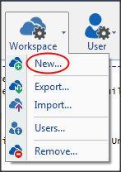
Workspace management using the DMU
Workspace management operations
The following operations can be undertaken using the Database Manager Utility:
Create a Workspace
Move a Workspace between databases
Delete (or remove) a Workspace
Assigning users to workspaces

Slide 15
Exercises and Review Questions
Exercise 1: Creating a Workspace
Exercise 2: Exporting a Workspace
Exercise 3: Importing a Workspace
Exercise 4: Deleting a Workspace
Question 1: What is a workspace? And what is the use of it?
Question 2: Explain how workspaces can be moved between difference DSS databases.
Question 3: Deleted workspaces cannot be recovered (True/False)

Slide 16
User Management Using the DMU

Slide 17
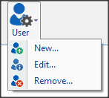
User management using the DMU
User management operations
The following operations can be undertaken using the Database Manager Utility:
Create a user
Edit user properties
Delete a user

Slide 18
User management using the DMU
User levels in the DSS
Database server manager:
Has access to all databases and workspaces.
Administrator:
Created by default when a new database is created.
Works as a system administrator for the database and its associated workspaces.
Can create other users, associated them with a workspace and has read-write access.

Slide 19
User management using the DMU
User levels in the DSS (cont.)
Workspace lead:
Created at the database level and then is associated as a workspace lead by an administrator.
Has a read-write access
Can associate other created users (by the Administrator) with the workspace
Leads but cannot add or remove users to the workspace

Slide 20
User management using the DMU
User levels in the DSS (cont.)
Workspace member:
Created at the database level and then is associated as a workspace member by an administrator or a workspace lead.
Has a read-write access but cannot create nor associate users.
Workspace reviewer:
Created at the database level and then is associated as a workspace reviewer by an administrator or a workspace lead.
Has only a read access and cannot create nor associate users.

Slide 21
Exercises and Review Questions
Exercise 1: Creating a user
Exercise 2: Editing user properties
Exercise 3: Assigning users to workspaces
Exercise 4: Deleting a user
Question 1: Assigning users to workspaces can be done using the ‘Users’ menu of the database manager utility (True/False)
Question 2: Users are created at the workspace level and then assigned a role (True/False)

Slide 22
DSS / System Manager Basics

Slide 23
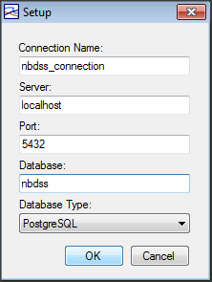
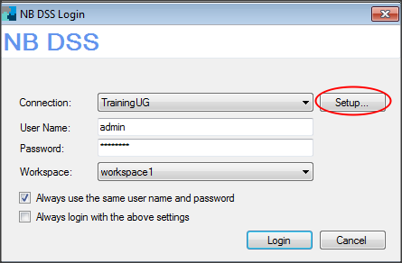
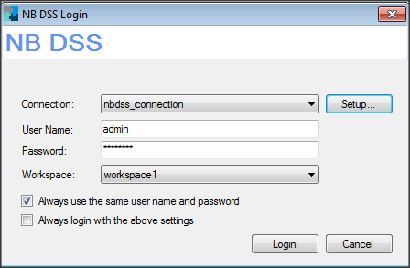
DSS Basics
Login to the DSS:
Start the program
Setup a connection
Login to particular workspace.

Slide 24
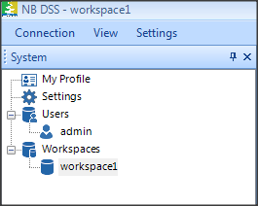
System Manager Basics
The System explorer has the following items:
My Profile: this shows the profile of the logged in user.
Settings: this shows the general settings of the DSS session.
Users: this group shows a list of the users logged into database
Workspaces: this shows the workspaces in the DSS database

Slide 25
Exercises and Review Questions
Exercise 1: Activating the System Explorer
Question 1: What are the inputs required to login to the DSS?
Question 2: If connection properties are wrong, how does the system informs you?

Slide 26
System Manager Functionality

Slide 27
System manager functionality
The System Manager offers a subset of the functions that are provided by the Database manager utility, namely:
Creating and editing users
Creating new workspaces and assigning users to them
The creation of new users and workspaces can only be undertaken by administrators

Slide 28
Exercises and Review Questions
Exercise 1: Creating a user
Exercise 2: Deleting a user
Exercise 3: Creating a workspace
Exercise 4: Assigning users to workspaces
Question 1: The System Manager offers same functionality as the Database manager utility (True/False)
Question 2: Any DSS user can create other users and workspaces. (True/False)

