Slide 1
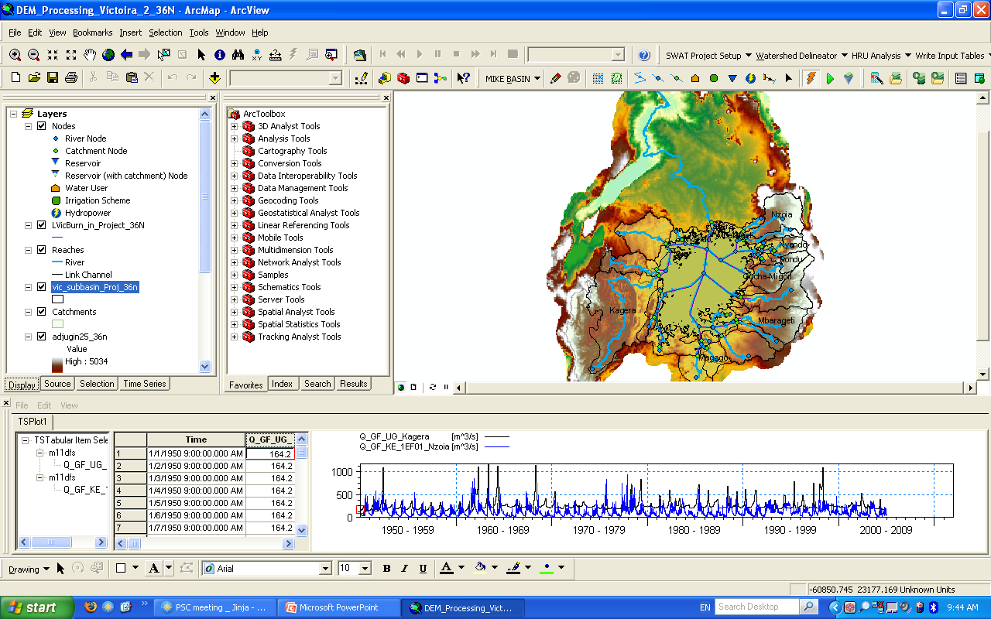
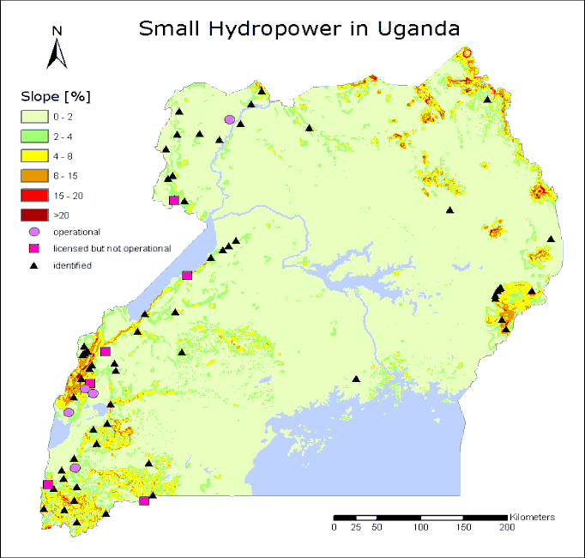
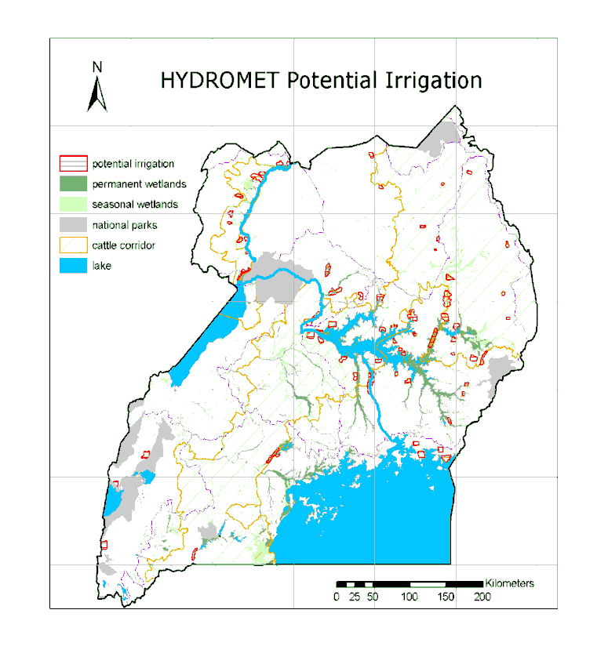
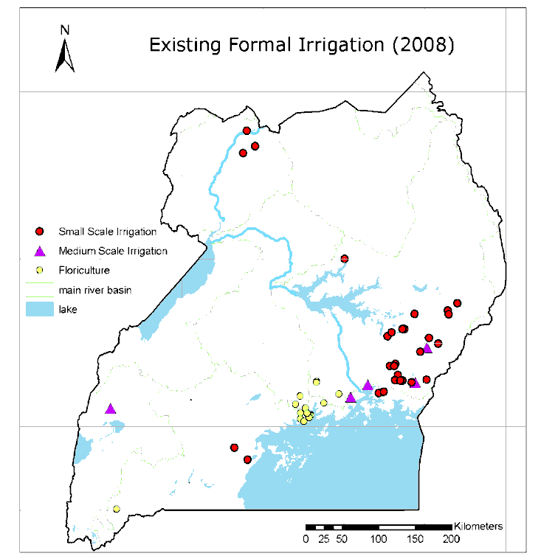
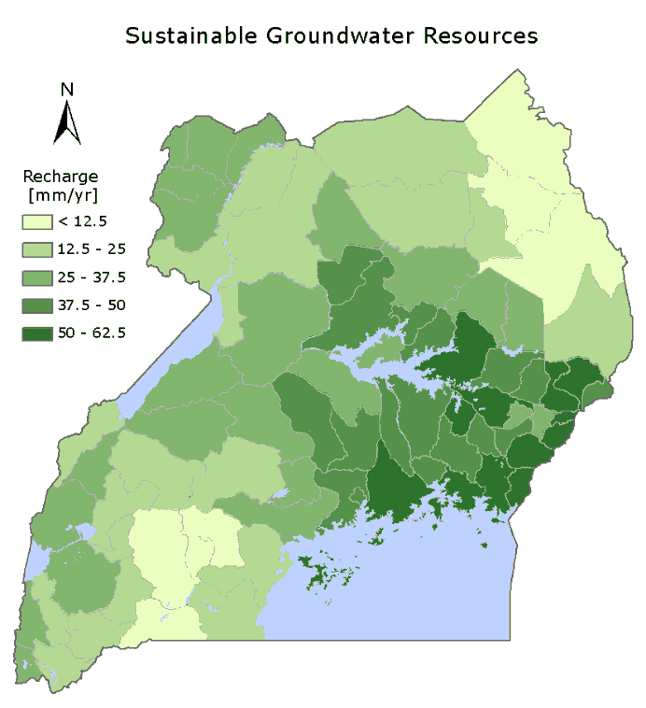
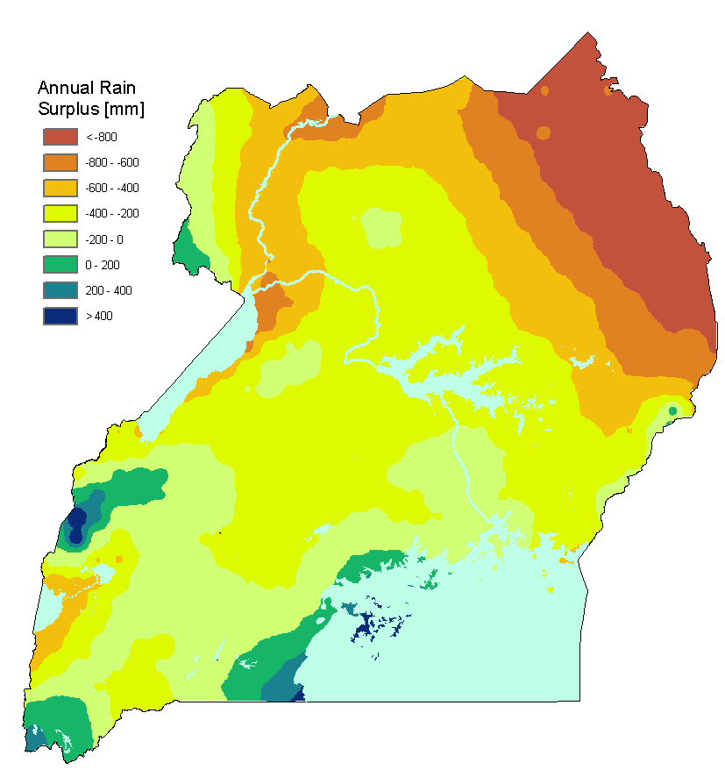
Application of the Nile DSS in the Dev’t of the National Water Resources Strategy for Uganda Nile Basin DSS User Community Workshop 2nd – 3rd October, 2015 Sowed Sewagudde Directorate of Water Resources Management Ministry of Water and Environment
National coverage of Mike Basin

Slide 2
Outline of presentation
Institutional anchorage of the Nile DSS
Nile DSS application cases in Uganda
Background to WR Strategy
Set up
Approach to modeling work
Key results
Conclusion and Recomendations

Slide 3
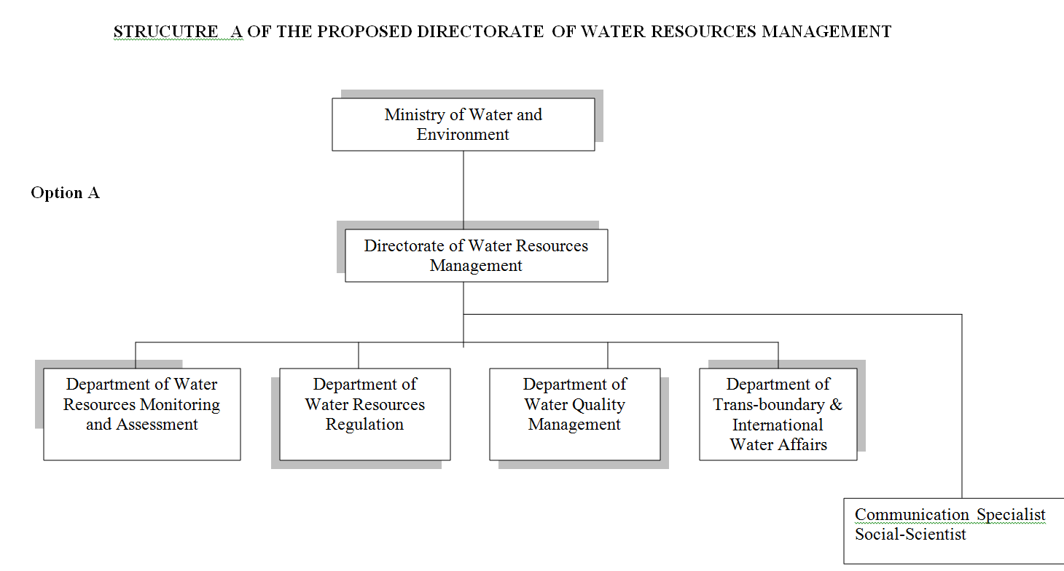
Institutional anchorage of the Nile DSS

Slide 4
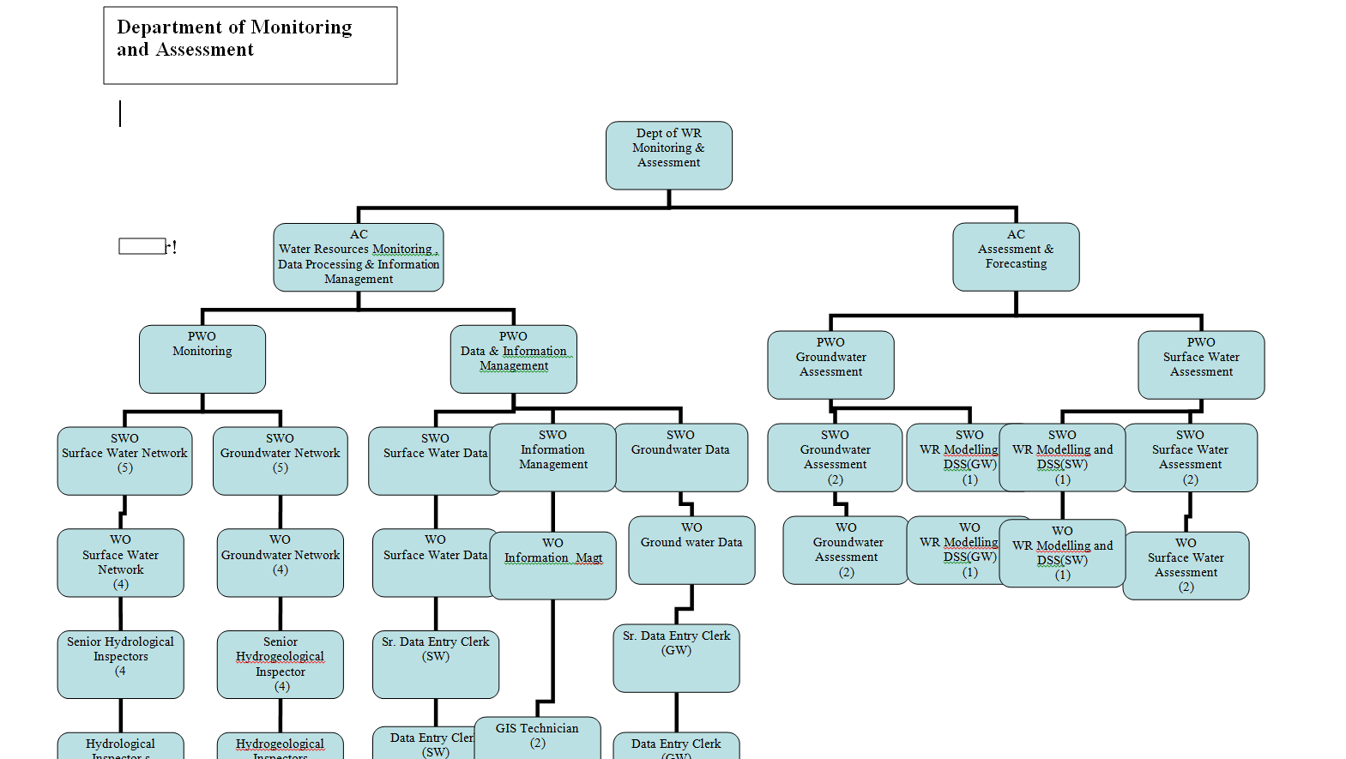

Slide 5
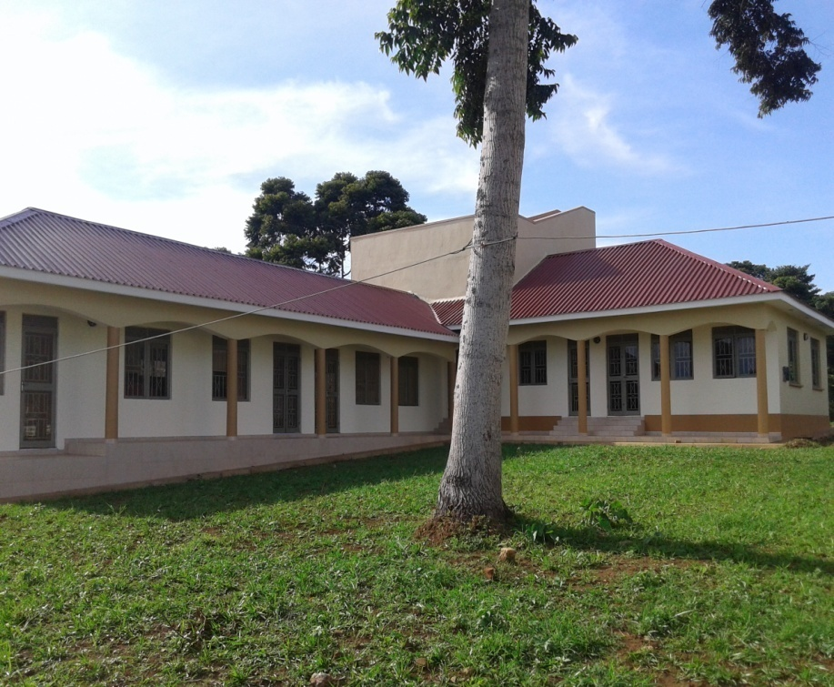
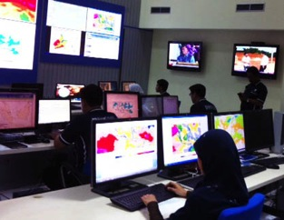
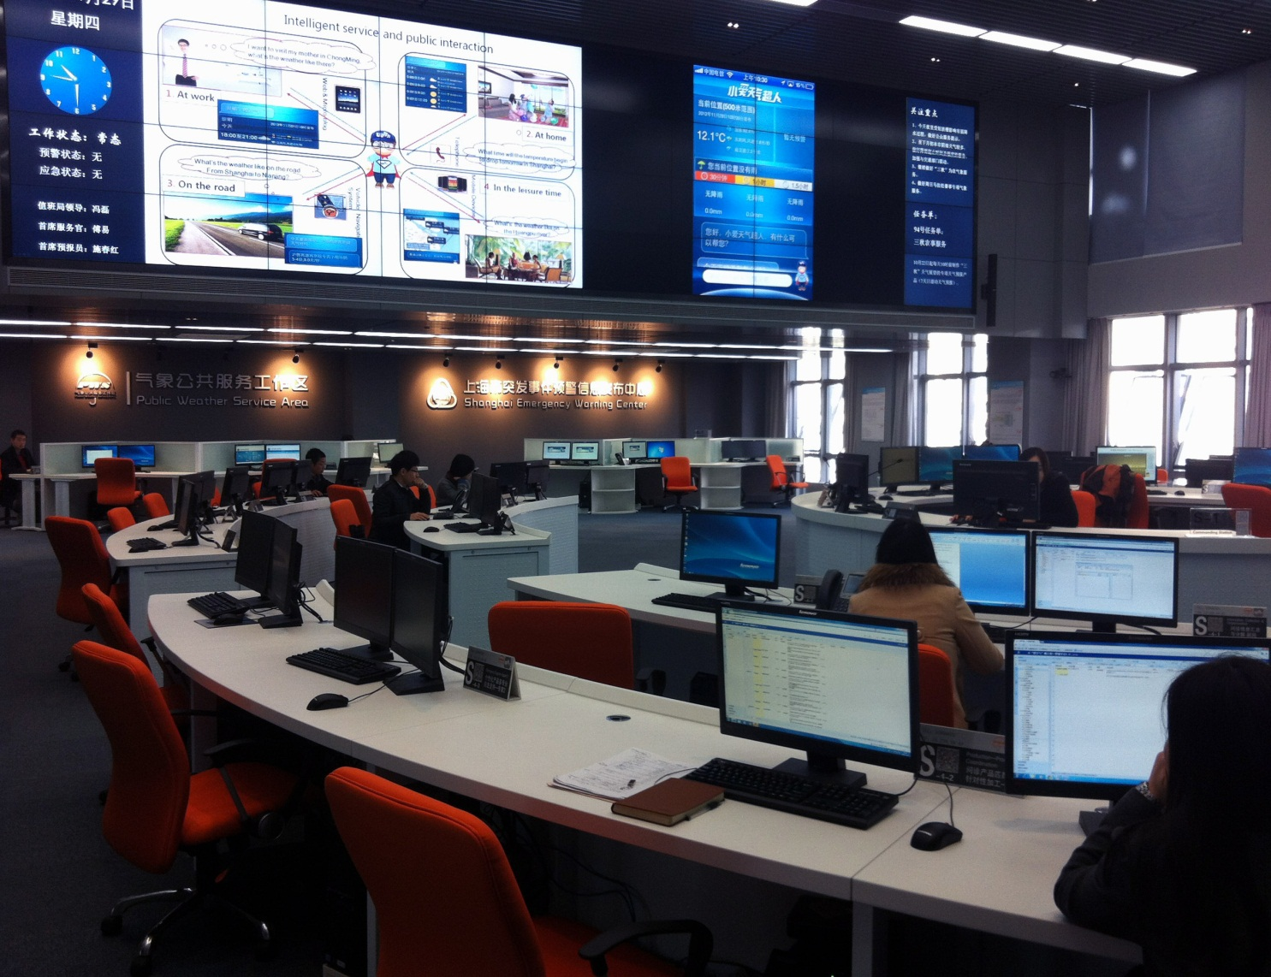
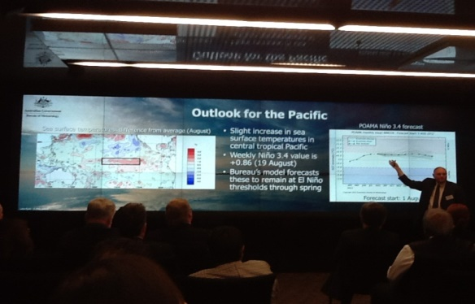
Home of the Nile DSS
Progress: Extension of the DWRM hydrological data centre completed and commissioned. ICT infrastructure is being procured to turn the facilitate into a one stop centre for Water and Environment Information and Knowledge centre - UWEIKC. -WIS

Slide 6
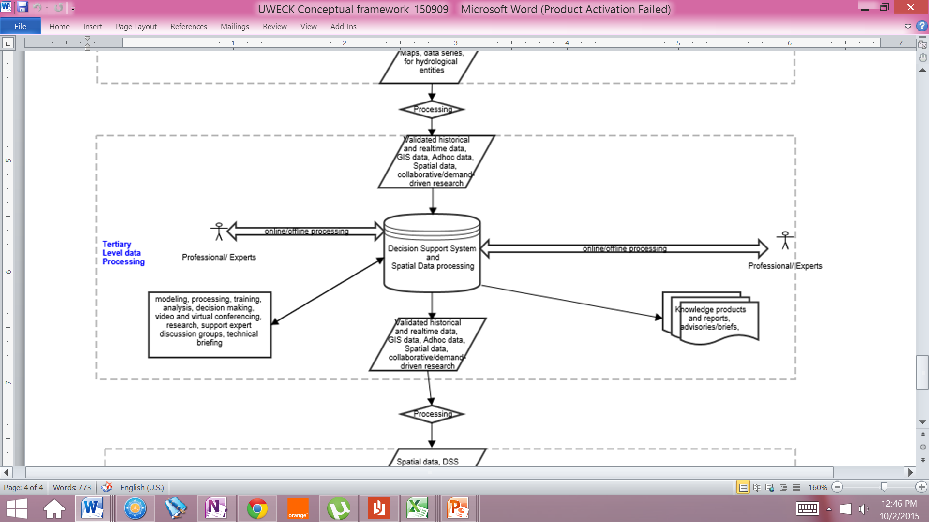
Conceptual Framework

Slide 7
Nile DSS application cases in Uganda
Pilot Catchment Planning – Awoja Catchment Management Plan
Mainstreaming of Climate Change in Catchment Management Plan – A for Awoja
Preparation of the National Water Resources Management and Development Strategy
Moving forward… Economic Evaluation of Water Resources
Assessment of 10 mini hydropower stations in the Albert Water Management Zone

Slide 8
Application of Nile DSS in Preparation of the National WR Strategy
In 2010, the Directorate of Water Resources Management (DWRM) initiated the process of preparing a National Water Resources Assessment and Strategy.
Comprehensive WR Assessment
- to provide information which would set the stage and guide management and development of the country’s water and related resources
Strategy
– to provide a framework for management and development of the country’s water and related resources by 2040

Slide 9
Set UP/ Approach
Climate Change
Regional and Transboundary context
National Development Objectives
Natural resource base
Uganda Vision 2040
?
Point
B
Point
A
How?
Resources?
Timing?
Priorities?

Slide 10
Objectives
Focus: hydrological modeling work as part of preparing a national Water Resources Management Strategy, undertaken in the Nile DSS decision support system
To assess the hydrological implications of the key national water resources development goals in Vision 2040.
To assess the possible trade-off between the different WR dev’t options with emphasis on HP generation, wetland and upland irrigation and downstream flow.
compare and discuss the pros and cons of different development options, including + environmental flow

Slide 11
Schematic of modeling approach

Slide 12
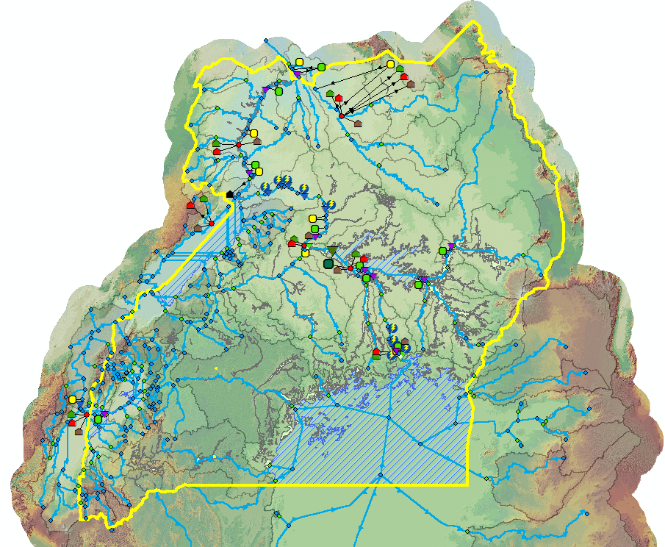
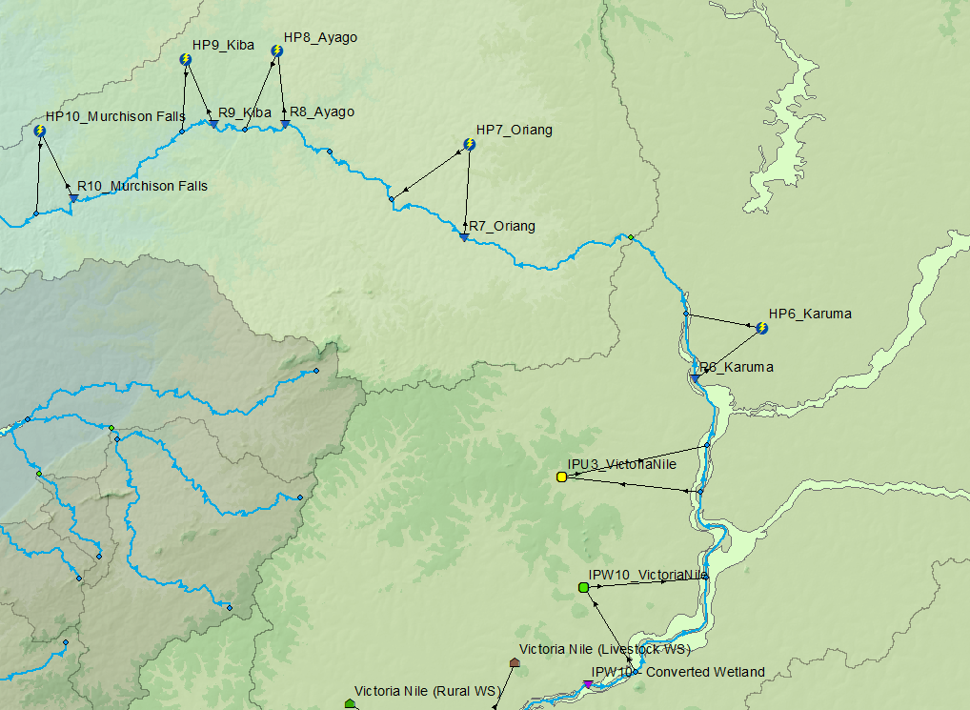
4 Scenario results
A set of 101 comparative indicators were defined to assess and compare the scenarios
The MIKE BASIN model for scenario S3a with full dev,t of major HPP along the Nile, and full wetland and upland irrigation potential according to Vision 2040
Model setup along the Kyoga Nile with 5 HPPs, irrigation nodes and water user nodes representing domestic water supply and livestock water uses

Slide 13
key results from all 10 scenarios
Sector / Theme | Hydro-power | Food Security Rice (Wetland) | Food Security Rice (Upland) | Food Security Maize | Food Security Vege-tables | Environ-mental flow | Lake Kyoga | Trans-boundary flow
Criteria | Hydro-power generation | Annual Crop Produc-tion | Annual Crop Produc-tion | Annual Crop Produc-tion | Annual Crop Produc-tion | >10% change in Low flow or >20% change in High flow | Mean surface area | Mean Annual Flow to Sudan
Unit | GWh/yr | 1000 ton/yr | 1000 ton/yr | 1000 ton/yr | 1000 ton/yr | Locations (%) | Km2 | m3/s
S0 | 3299 | 506 | 0 | 0 | 0 | 0 | 3503 | 1208
S1 | 19449 | 506 | 0 | 0 | 0 | 0 | 3503 | 1207
S1A | 26836 | 506 | 0 | 0 | 0 | 0 | 3502 | 1207
S2 | 19323 | 2480 | 0 | 0 | 0 | 8 | 3488 | 1195
S2A | 26660 | 2480 | 0 | 0 | 0 | 8 | 3488 | 1195
S3 | 18886 | 2480 | 692 | 1430 | 11177 | 42 | 3447 | 1143
S3A | 26047 | 2480 | 692 | 1430 | 11177 | 42 | 3447 | 1143
S4A | 19179 | 2480 | 0 | 1441 | 11177 | 8 | 3475 | 1179
S4B | 19272 | 2480 | 0 | 0 | 11177 | 8 | 3483 | 1187

Slide 14
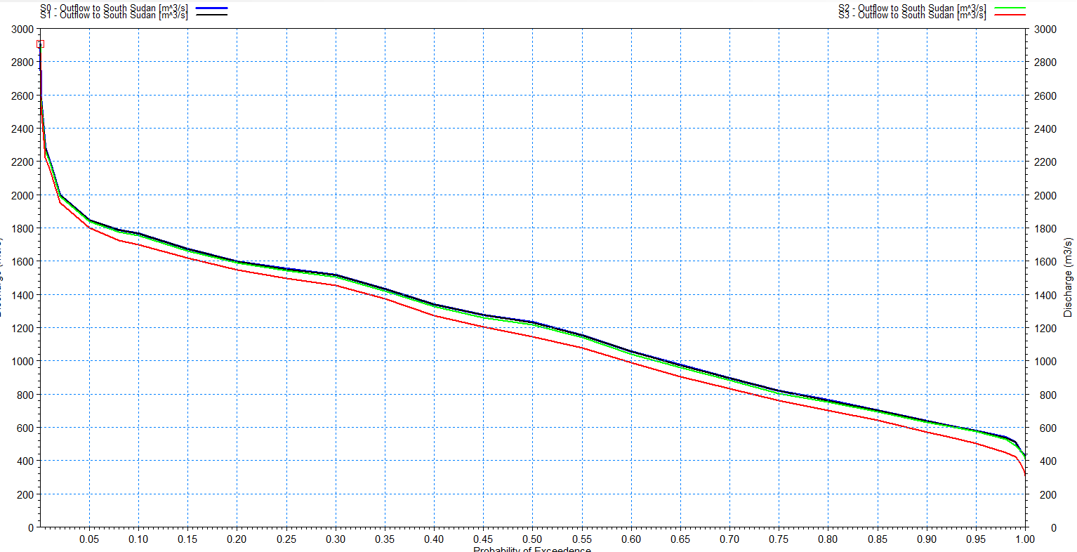
Key results – implications of scenarios
hydrographs and FDC for outflow to South Sudan for the scenario S0, S1, S2 and S3

Slide 15
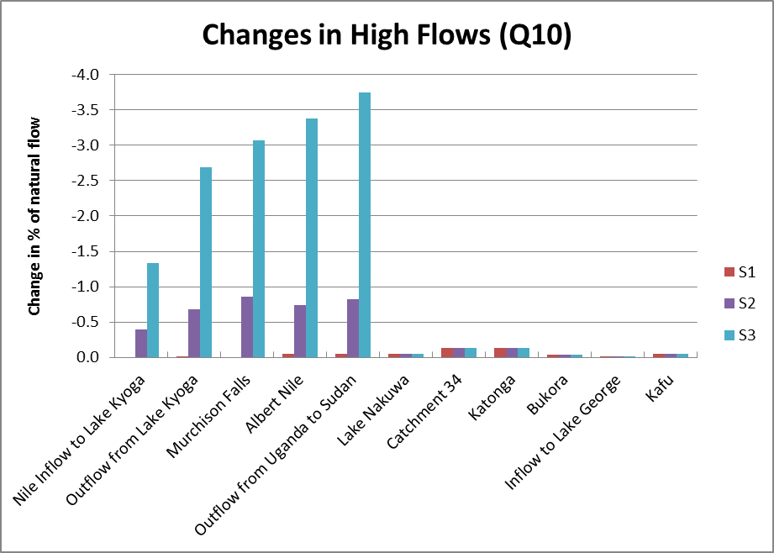
Environment Flow Assessments

Slide 16
Multi-Criteria-Analysis (MCA)
Purpose: to screen various combinations of dev,t options, and quickly identify the key trade-offs and implications on the main socio-economic sectors in the country. Promising solutions can then be further refined and analysed.
Setup of the Multi-Criteria-Analysis
1) Selection and design of criteria;
2) Computing the score for each criteria for each scenario;
3) Normalizing the scores;
4) Weighting the criteria – assessing their relative importance;
5) Calculating the overall performance of each scenario

Slide 17
Criteria defined for each of the sectors in MCA and the chosen weights.
 | Sector / Theme | Criteria | Weight of criteria | Unit | Model-based criteria (Yes/No)
1 | Domestic Water Supply | Mean annual water deficit | 6 | % | Yes
2 | Hydropower Generation | Total mean annual power production | 35 | GWh/yr | Yes
3 | Food Security | Mean annual crop production | 35 | 1000 ton/yr | Yes
4 | Tourism & Wildlife | General score Each of the following things has reduced the score by -1: 1) Wetland irrigation, 2) Upland irrigation, 3) HP developments which include Murchison Falls and Kalagala. | 6 | [ - ] | No
5 | Livestock | Mean annual water demand deficit | 4 | % | Yes
6 | Fisheries & Aquaculture | General score reduced score by -1: 1) Wetland irrigation, 2) > 25% flow reduction, 3) > 25% increase in lake level fluctuations. | 2 | [ - ] | No
7 | Environmental Flow | Locations with more than 10% change in low flow or more than 20% change in high flow | 2 | % | Yes
8 | Water Quality | General score reduced the score by -1: 1) Wetland irrigation, 2) Upland irrigation, 3) HP developments (more industry) and 4) Oil & Gas production. | 2 | [ - ] | No
9 | Navigation | General score Each of the following things has reduced the score by -1: 1) > 25% flow reduction, 2) > 25% increase in lake level fluctuations. | 2 | [ - ] | No
10 | Transboundary Flow | Mean annual flow to South Sudan | 4 | m³/s | Yes
11 | Oil & Gas | Mean annual water demand deficit | 2 | % | Yes

Slide 18
Scores and ranks of the ten scenarios

Slide 19
Incremental production volume for hydropower, wetland and upland irrigated crops caused by scenarios 1, 2 and 3
Scenario | Incremental HP production volume as compared to present situation (Scenario 0) |  | Incremental crop production volume as compared to present situation (Scenario 0) |  |  |  | Outflow to South Sudan as compared to present situation m3/s
 | MW | GWh | Wetland rice-tons | Upland rice-tons | Upland maize-tons | Upland tomatoes-tons
0 | 376.4 |  | 506,375.1 |  |  |  | 1,208.04
1 | 1842.3 | 16,138.5 |  |  |  |  | 1,207.25
2 | 1828.6 | 16,018.5 | 1.973,465 |  |  |  | 1,195.46
3 | 1782.4 | 15,613.8 | 1.973,465 | 692,436 | 1.429,619 | 10.699,945 | 1,142.83

Slide 20
Results of the economic assessment.
Based on a discount rate of 0.06,
Scenario No. | NPV, million US$ | Economic internal rate of return (%) | Direct employment creation
Scenario 1 | 159.1 | 20% | Employment creation in the hydropower subsector
Scenario 2 | 289.1 | 23% | Employment creation in the hydropower and wetland irrigation sub-sector
Scenario 3 | 1330.1 | 36% | Employment creation in the hydropower and wetland and upland irrigation sub-sectors
from an economic or society viewpoint all 3 scenarios are viable. However, scenario 3 generates the highest NPV and the highest return

Slide 21
Investment cost for Scenario 3
 |  | Ha. of cultivated crop | Investment cost per unit | Total investment cost (million US$) | Average crop yield/Ha (tons) | Annual Production Volume
1.HP |  |  | 3.033 million US$/MW | 5,406 |  | 1782.4 MW
2. Wetland irrigated rice |  | 247,226 | 4,500 US$/ha | 1,113 | 4.0 | 1,973,465 tons
3.1 Upland irrigated rice | Rice | 14,391 | 2,500 US$/ha | 36 | 3.0 | 692,436 tons
 | Rice Maize | 218,135 | 2,500 US$/ha | 545
3.2 Upland irrigated maize | Maize | 25,286 | 2,000 US$/ha | 50 | 5.0 | 1,429,619 tons
 | Maize Rice | 218,135 |  | Included in 3.1
 | Maize Beans | 43,121 | 2,000 US$/ha | 86
3.3 Upland irrigated tomatoes |  | 136,132 | 2,500 US$/ha | 340 | 26.1 | 10,699,945 tons
3.4 Upland irrigated beans | Beans Maize | 43,120 | 2,000 US$/ha | Included in 3.2 | 4.9 | 210,146 tons
Total investment cost |  |  |  | 7,576

Slide 22
Conclusions
no major water allocation conflicts are anticipated by 2040, and, consequently, no ‘hard choices’ need to be made at national level regarding water related dev’ts
Domestic Water Supply, Livestock, Oil & Gas, and Navigation can be met in all scenarios.
scenario 3 - generates the highest Net Present Value (NPV) and the highest return (IRR)
full dev’t of the upland irrigation reduces Q₉₀ along the Nile by up to 12%

Slide 23
Conclusions
study demonstrates that to support policy and decision making regarding WR planning, DWRM needs a tool to screen combinations of dev’t options, and quickly identify trade-offs and implications on the main socio-economic sectors in the country.
The methodology developed can serve as a template for supporting future WRM and planning decisions at national, basin, and catchment level.

Slide 24
Challenges
National Master Nile DSS model is in Mike Basin platform which is obsolete
Lack of full time staff to work with the DSS on a day to days basis
Development of indicator scripts

Slide 25
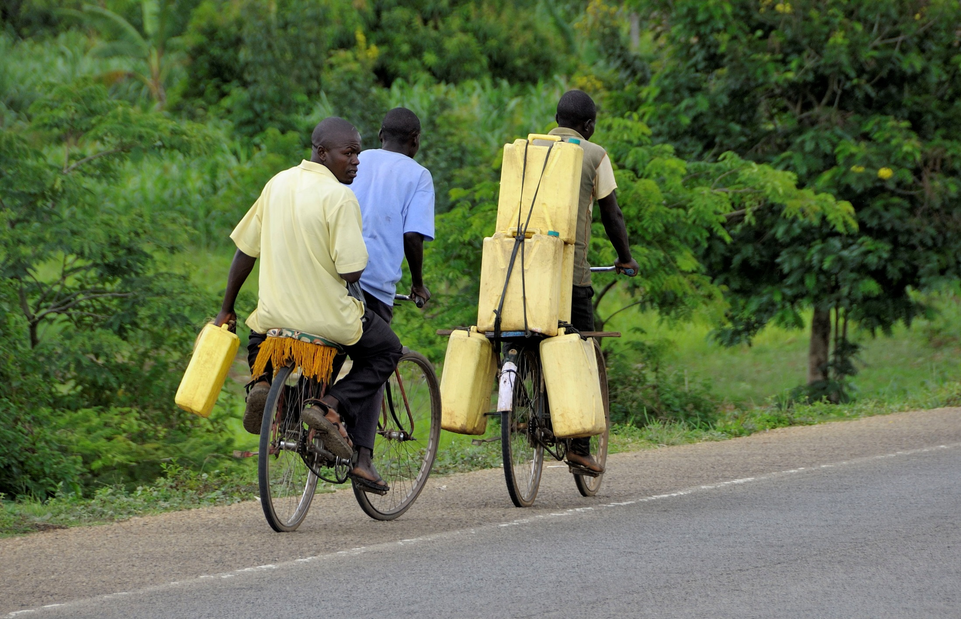
Sewagudde Sowed
Senior Hydrologist & Water Resources Modeller
Directorate of Water Resources Management
Ministry of Water and Environment, Uganda
Photo: Jens Kristian Lørup

