Slide 1
DSS Training Material
Modeling tools Training Module
Modeling tools Module
NBI Secretariat

Slide 2
What you learn in this module?
This module Introduces you to
MIKE HYDRO.
MIKE NAM.
MIKE 11
MIKE SHE

Slide 3
MIKE HYDRO

Slide 4
MIKE HYDRO
MIKE HYDRO is the Graphical User Interface framework for some of the DHI Water resources software products.
It features a map based and easy-to-use Graphical User Interface and will, in the coming releases, integrate the DHI Water resources products into one, common GUI framework.
MIKE HYDRO Release 2014 includes the following modules:
Basin module (MIKE HYDRO Basin)
River module (MIKE HYDRO River)

Slide 5
MIKE HYDRO
Applications related to the MIKE HYDRO Basin module include:
Integrated Water Resources Management studies
Provision of multi-sector solution alternatives to water allocation and water shortage problems
Reservoir and hydropower operation optimization
Exploration of conjunctive use of groundwater and surface water
Irrigation scheme performance improvements

Slide 6
MIKE HYDRO Interface

Slide 7
Live Demo

Slide 8
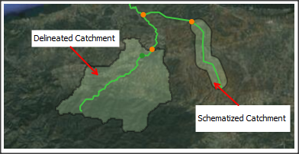
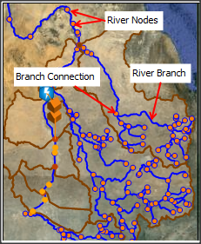
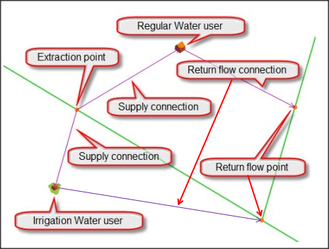
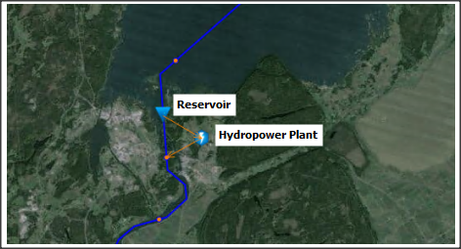
MIKE HYDRO Interface
MIKE HYDRO model objects
Catchment
River (links and nodes)
Reservoirs and Hydropower Plants
Water user Nodes

Slide 9
MIKE HYDRO Exercise
Configure and run a simple MIKE HYDRO model

Slide 10
MIKE NAM

Slide 11
MIKE NAM
NAM is a Danish acronym for 'Nedbør-Afstrømings-Model' which means 'Precipitation-Runoff-Model'.
NAM is a rainfall-runoff module of MIKE HYDRO and MIKE 11 river modeling systems.
It can be applied independently or used to calculate the runoff generated in one or more contributing catchments that generate lateral inflows to a river network

Slide 12
MIKE NAM
Typical Applications related to the NAM include:
Runoff forecasts
Extension of runoff series
Estimate effects of Climate Change, for instance on stream flow

Slide 13
Model Structure
SOIL MOISTURE PROFILE
QOF
Overland Flow
CK1
CK2
SNOW
SNOW
STORAGE
RAIN
OF
IF
Owp Ofc Osat
P
Ep
Pn
Ps
Root Zone
L
Umax
U
QIF
InterFlow
SURFACE STORAGE
Ea
DL
Lmax
Lmax
LOVER ZONE STORAGE
L
Sy
G
CAFlux
GWL
GWPump
BFu
GWL
CKBF
BF
BaseFlow
GROUNDWATER STORAGE
Depth
GWLBFo

Slide 14
Snow Storage
Optional:
Temperature data only required if snow is included
SNOW
Snow Storage
P_{s}
Surface Storage
Q_{melt}: Degree day coefficient [mm/centigrade/day]
P_{s} = 0 , Temp < 0
P_{s} = f (Q_{melt}) , Temp > 0

Slide 15
Surface Storage
QOF
Overland Flow
CK1
CK2
Precipitation
OF
IF
P
Ep
Pn
Umax
SURFACE STORAGE
U
QIF
InterFlow
Infiltration

Slide 16
Lower Zone Storage
Ea
DL
Lmax
LOVER ZONE STORAGE
L
CAFlux
Infiltration / Recharge

Slide 17
Groundwater Storage
G
CAFlux
GWPump
BFu
GWL
CKBF
BF
BaseFlow
GROUNDWATER STORAGE
GWLBFo

Slide 18
Live Demo

Slide 19
MIKE NAM Exercise
Configure and run a simple MIKE NAM model

Slide 20
MIKE 11

Slide 21
MIKE 11
MIKE 11 is a professional engineering software package for the simulation of flows, water quality and sediment transport in estuaries, rivers, irrigation systems, channels and other water bodies.
It is a one-dimensional modeling tool for the detailed analysis, design, management and operation of both simple and complex river and channel systems.
The Hydrodynamic (HD) module is the core of the MIKE 11 modeling system and forms the basis for most modules including Flood Forecasting, Advection-Dispersion, Water Quality and sediment transport modules)

Slide 22
MIKE 11
Typical applications of MIKE 11 HD module include:
Flood forecasting and reservoir operation
Simulation of flood control measures
Operation of irrigation and surface drainage systems
Design of channel systems
Tidal and storm surge studies in rivers and estuaries

Slide 23
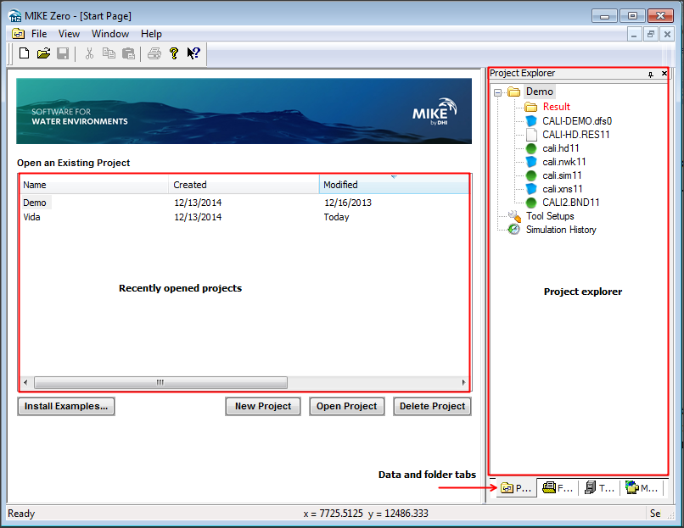
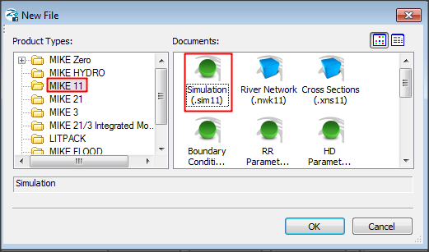
MIKE 11 Interface
MIKE 11 is integrated into the MIKE Zero interface

Slide 24
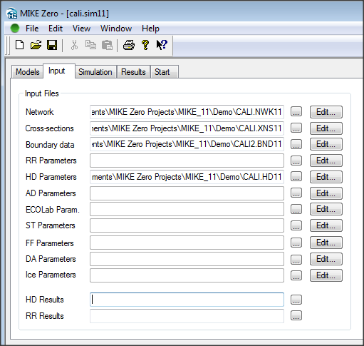
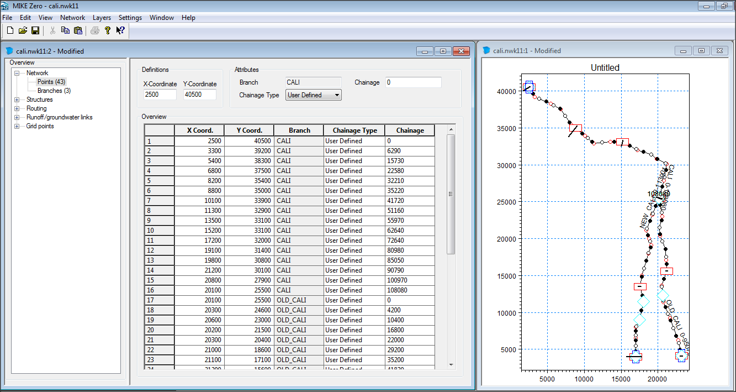
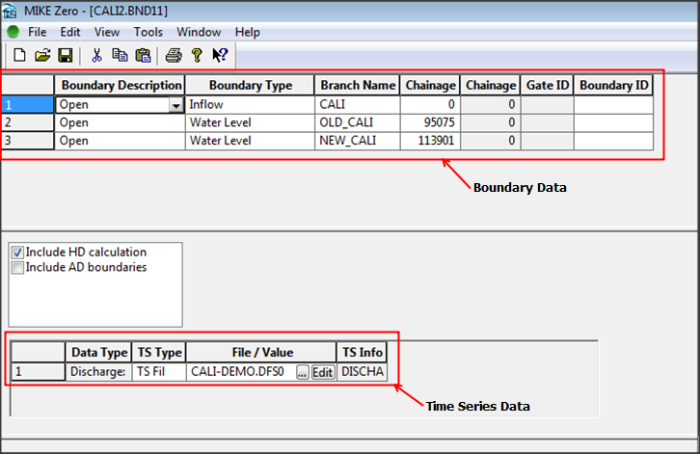
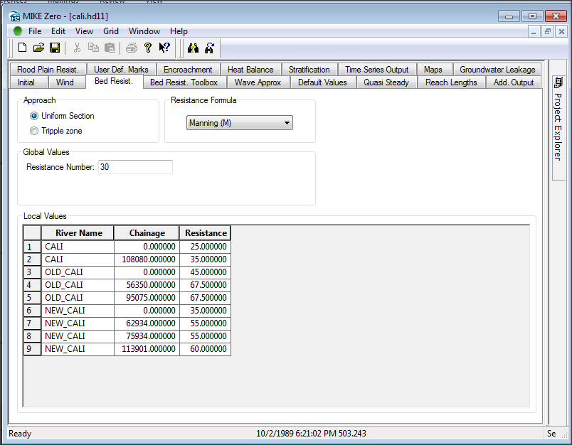
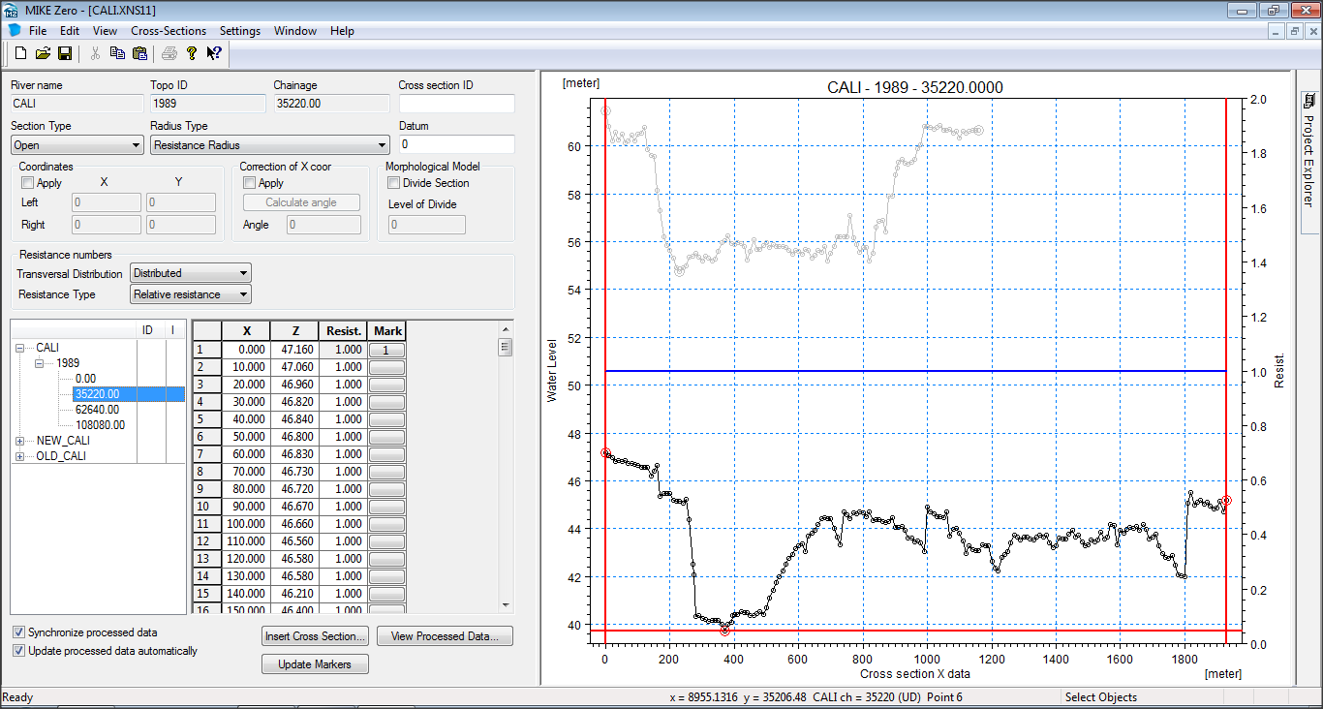
MIKE 11 Interface
MIKE 11 Editors
The Simulation Editor
The Network Editor
The Cross-section Editor
The Boundary Editors
The Parameter File Editors

Slide 25
Live Demo

Slide 26
MIKE 11Exercise
Configure and run a simple MIKE 11 model

Slide 27
MIKE SHE

Slide 28
MIKE SHE
A modeling framework
Including a range of numerical methods for each hydrological process.
Has an advanced, conceptual, model independent user interface for all hydrological processes.
The hydrological processes and numerical methods can be combined, depending on the requirements of your application and the availability of data.
All numerical engines are parallelized to make efficient use of available multi-core resources

Slide 29
MIKE SHE
Typical applications for which MIKE SHE is often used:
Conjunctive use and management of surface water and groundwater
Irrigation and drought management
Wetland management and restoration
Environmental river flows
Floodplain management
Groundwater induced flooding
Land use and climate change impacts on groundwater and surface water
Nutrient fate and management
Integrated mine water management

Slide 30
MIKE SHE Interface
The MIKE SHE user interface is organized by task. In every model application you must:
Set up the model,
Process the data
Run the model, and view the results.
The above three tasks are carried until you obtain the results that you want from the model.

Slide 31
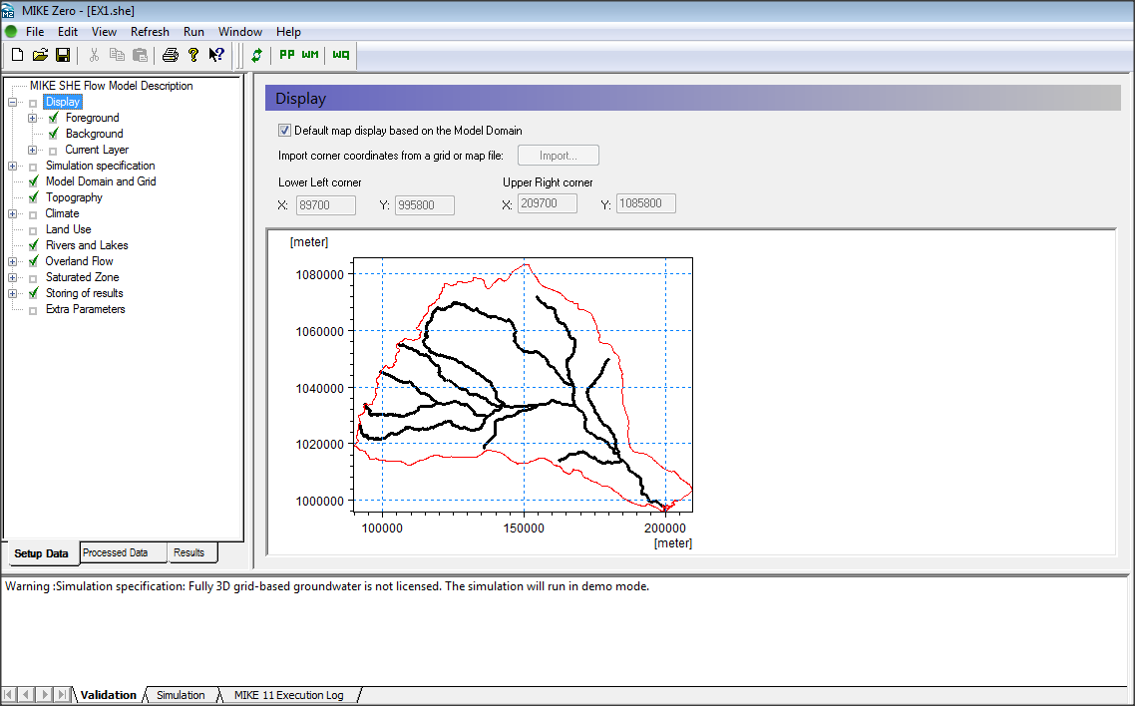
MIKE SHE Interface
Data Tree
Data Pane
Data Validation

Slide 32
Live Demo

Slide 33
MIKE SHE Exercise
Configure and run a simple MIKE SHE model

