Slide 1
DSS Training Material
Analysis Manager Training Module
Analysis Manager Module
NBI Secretariat

Slide 2
What will you learn in this module?
This module Introduces you to
  MCA and CBA concepts.
  Analysis Manager basics.
  CBA setup
  CBA sessions and comparisons
  MCA setup
  MCA sessions and comparisons

Slide 3
CBA / MCA Concepts

Slide 4
CBA concepts
What is CBA?
  A Cost Benefit Analysis (CBA) is an assessment of all the costs and benefits of alternative options to evaluate if the benefits outweigh costs.
  CBA seeks to value the expected performance of an option (i.e. scenario) in monetary terms.
  These valuations are based on a well-developed economic theory of valuation.
How CBA results are reported?
CBA typically uses one of several metrics to report findings. Examples are, the benefit-cost ratio, return on investment, and net present value .

Slide 5
CBA concepts
The typical workflow of a CBA process?
  Financial experts provide discount rates, external costs/benefits/funding data
  Experts calculate expected benefits (and sometimes costs) using models
  CBAs are created for different scenarios
  Sensitivity of CBA results with respect to discount rates is assessed
  CBA results from different scenarios are compared
  Financially most viable scenario(s) (not necessarily profitable) is(are) identified

Slide 6
CBA concepts
The typical workflow of a CBA process in the DSS?
  Create Models
  Define Scenarios for the Models
  Define Indicators for model outputs
  Run (at least one) simulation per scenario
  Review the evaluated Indicators
  Create a CBA Setup
  Create one or more CBA Sessions
  Create a CBA Session Comparison

Slide 7
CBA concepts
What are the CBA pre-requisites in the DSS?
  A model is created for the problem to be analyzed.
  The created model is registered within the DSS.
  At least one scenario is created for the registered model
  One simulation is run successfully for the above scenario
  The Time length of the CBA has to be decided
  Cost and benefits are calculated either based on the simulation results or other sources (e.g. expert judgment)
  The discount rates for the costs and benefits of each of the scenario measures have to be decided.

Slide 8
MCA concepts
What is MCA?
  A Multi Criteria Analysis (MCA) is used for the appraisal of options for policy and other decisions which do not necessarily rely on monetary valuations.
  MCA establishes preferences between options by reference to an explicit set of objectives that the decision making body has identified
  For each objective, established measurable indicators and/or criteria are used to assess the extent to which the objective has been achieved.

Slide 9
MCA concepts
How MCA results are reported?
A standard feature of multi-criteria analysis is a decision matrix in which each row describes an option and each column describes the performance of the options against an indicator and/or criterion. The individual performance assessments are often numerical, but may also be expressed as color coding.

Slide 10
MCA concepts
The typical workflow of a CBA process?
  Establish the decision context. What are the aims of the MCA?
  Identify the objectives and criteria that reflect the value associated with the consequences of each option.
  Generate the Scenarios (or options).
  Evaluate the performance of each option against the criteria.
  ‘Weighting’. Assign weights for each of the criteria to reflect their relative importance to the decision.
  Combine the weights and scores for each of the options to derive and overall value.
  Examine the results and conduct a sensitivity analysis of the results to changes in scores or weights.
  Select acceptable scenario/option.

Slide 11
MCA concepts
The typical workflow of a MCA process in the DSS?
  Create Models
  Define Scenarios for the Models
  Define Indicators for model outputs
  Run (at least one) simulation per scenario
  Review the evaluated indicators
  Create an MCA Setup
  Create one or more MCA Sessions
  Create an MCA Session Comparison

Slide 12
MCA concepts
What are the MCA pre-requisites in the DSS?
  A model setup or more is created for the problem to be analyzed.
  The created model setup(s) is registered within the DSS.
  Indicators that will be used in the MCA are defined for each model setup.
  Two or more scenarios are created for the registered model(s) either for one setup or several setups
  At least one simulation is run successfully for each of the above scenarios and the values of the indicators are calculated (i.e. scripts required are written and working), reviewed, and error free.
  Criteria to evaluate different options have been decided as well as the normalization and weighting methods to be used. For each criterion, the algorithm for calculation and the desired direction of improvement (i.e. whether higher values or lower values are better off) have been decided

Slide 13
The Analysis Manager Basics

Slide 14
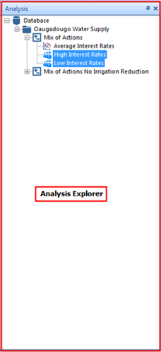
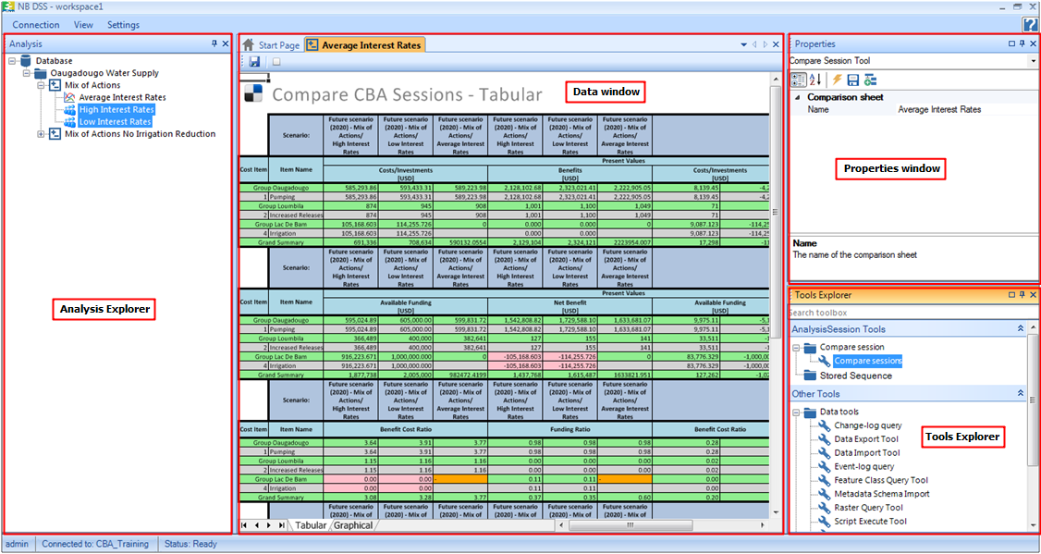
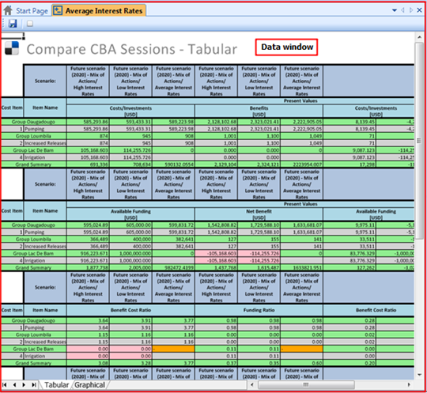
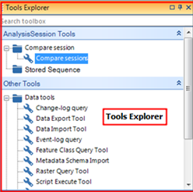
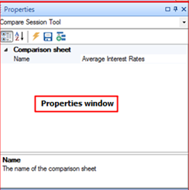
The Analysis Manager basics - Components
The Analysis Explorer
The data view.
Tools Explorer window
The Properties Window.

Slide 15
Exercises and Review Questions
Exercise 1: Activating the Analysis Manager
Exercise 2: Adding a ‘user defined’ group
Question 1: What is meant by CBA and MCA?
Question 2: Describe the process of undertaking a CBA in the DSS?
Question 3: Describe the process of undertaking an MCA in the DSS?
Question 4: What are the CBA pre-requisites?
Question 5: What are the MCA pre-requisites?
Question 6: Layers are viewed in map and a table windows by default when opened in the DSS. (True/False)

Slide 16
CBA Setup

Slide 17
CBA Setup
In a CBA setup within the DSS, you define the following:
  Evaluation Period
  Monetary Units
  Scenario
  The costs and benefits data of the scenario measures with their discount rates and units
  Funding and benefits minimum data of the scenario measures with their discount rates and units (optional).
  Conversion factors.

Slide 18
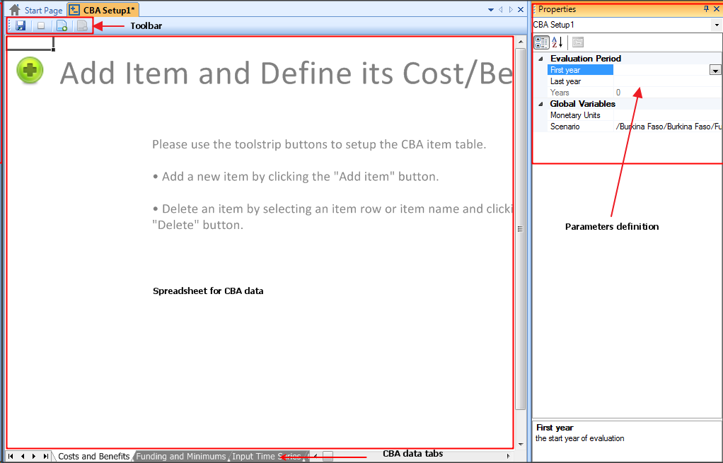
CBA Setup
The CBA setup window components.

Slide 19
CBA concepts
CBA Setup Terminology
  Discount Rate: The interest rate you could earn on your money
  Present Value: Value on a given date of a payment or series of payments made at other times.
  Break Even Year :Year at which aggregate benefits balance or exceed aggregate costs.

Slide 20
Exercises and Review Questions
Exercise 1: Creating a CBA setup
Question 1 : What is a CBA setup in the DSS?

Slide 21
CBA Sessions and Comparison

Slide 22
CBA Sessions and comparison
What is a CBA session?
  A CBA Session is created based upon a CBA setup.
  It includes the information of the CBA Setup but you can vary certain properties of CBA items such as the discount rates to check the viability of a scenario under different conditions.
  In the DSS, one CBA Setup can include several CBA Sessions but once a CBA Session is created under a CBA setup, the setup cannot be edited anymore unless all its CBA sessions are deleted.
  In a session, the CBA metrics are summarized

Slide 23
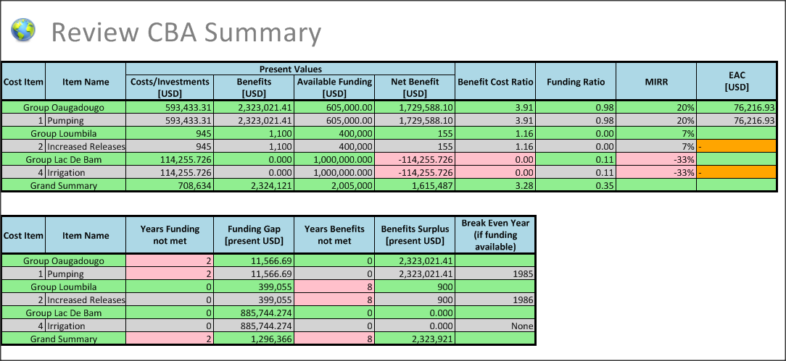
CBA Sessions and comparison
CBA session summary?
Total costs
Total Benefits
Net Benefits
MIRR
Break Even Year

Slide 24
CBA Sessions and comparison
What is a CBA comparison?
  In a CBA comparison, you can compare a number of CBA sessions.
  These sessions can be under the same CBA setup or different setups.
  A comparison is run using the 'Compare sessions' tool from the 'Tools' explorer.

Slide 25
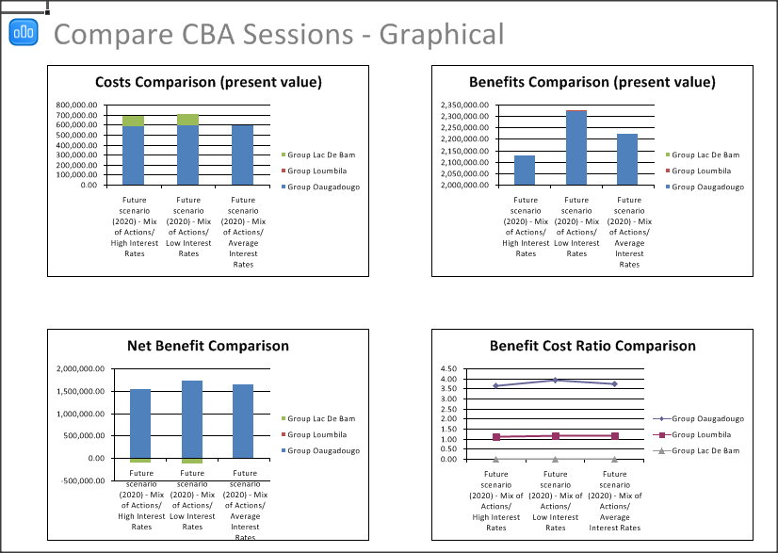
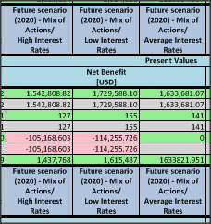
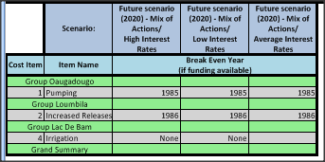
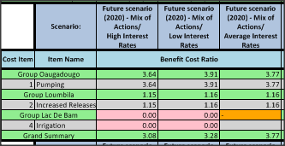
CBA Sessions and comparison
What is a CBA comparison?
  In a CBA comparison, you can compare the CBA metrics from different CBA Sessions in tabular or graphical formats.
Net Benefits
Break Even Year
Benefit Cost Ratio
Graphical comparison

Slide 26
Exercises and Review Questions
Exercise 1: Creating a CBA session and visualizing the results
Exercise 2: Clone and edit a CBA session
Exercise 3: Cloning and modifying a CBA setup
Exercise 4: Creating a CBA comparison
Question 1: What is a CBA session?
Question 2: What is a CBA comparison?

Slide 27
MCA Setup

Slide 28
MCA Setup
In the DSS, an MCA setup is where you select:
  The scenarios that will be evaluated
  Indicators that will be used to evaluate the scenarios.
  Criteria that is based on the indicators which needs be exhaustive and consistent, and in that case they are called non-redundant

Slide 29
MCA Setup
After defining the criteria, the next step is to normalize them. Normalization is an important process to ensure that the different criteria values are comparable.
Normalization can be done using either:
  Percentage of Maximum
  Percentage of Range
  Percentage of total
  Unit Vector

Slide 30
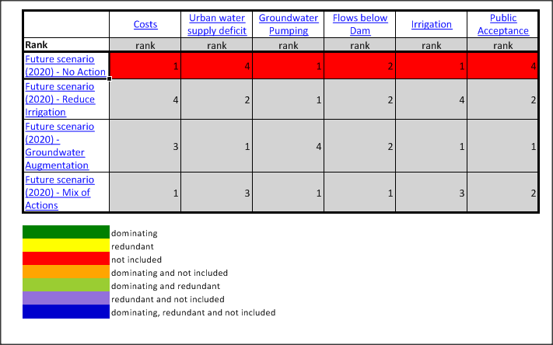
MCA Setup
After normalization, a decision matrix is assembled.
This matrix should always be subjected to a simple, structured review before the analysis proceeds to remove redundant criteria and identify dominant scenario(s).

Slide 31
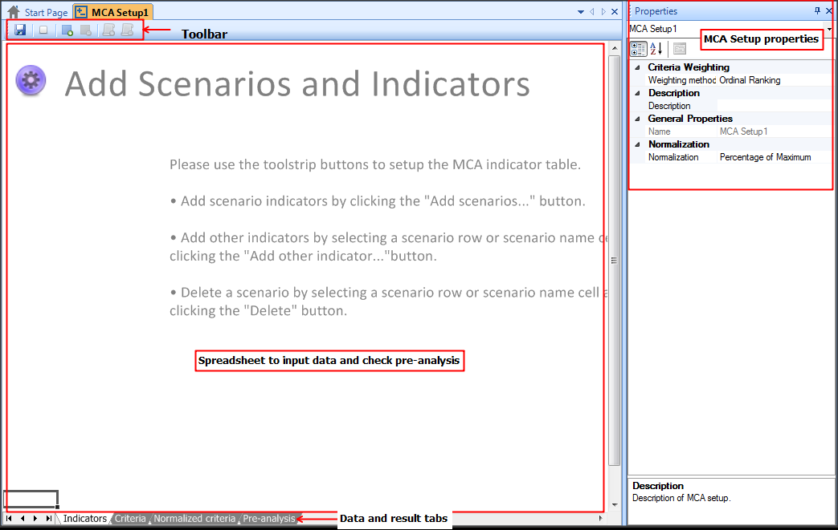
MCA Setup
The MCA setup window:

Slide 32
Exercises and Review Questions
Exercise 1: Creating an MCA setup
Question 1 : What is an MCA setup in the DSS?

Slide 33
MCA Sessions and Comparison

Slide 34
MCA Sessions and comparison
What is an MCA session?
  An MCA Session is created based upon an MCA setup.
  One MCA Setup can include several MCA Sessions.
  Typically, each stakeholder could have his/her own session.
  In a session, you can have only one set of limits (upper and lower) per criterion. No matter how many stakeholders are there, the set of limits have to be agreed for each session.

Slide 35
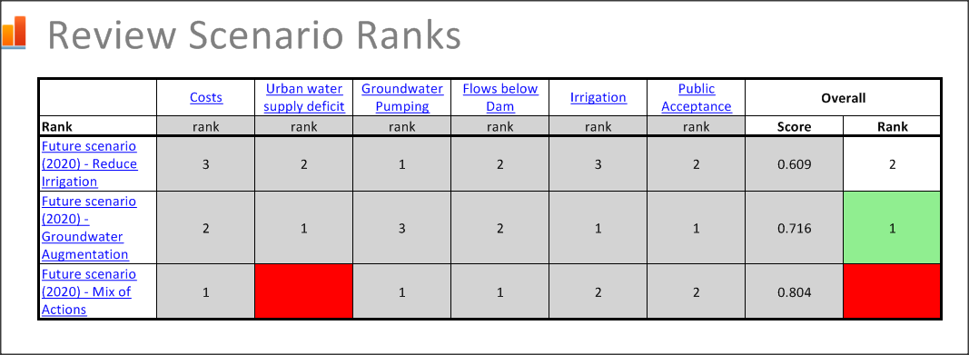
MCA Sessions and comparison
What is an MCA session?
  Scenarios including criteria that violate these limits are not included in the ranking of scenarios and are kept but marked red.

Slide 36
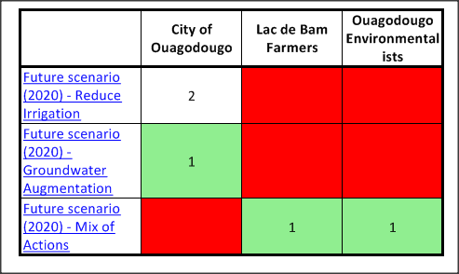
MCA Sessions and comparison
What is an MCA comparison?
  In an MCA comparison, you can compare a number of MCA sessions.
  These sessions have be under the same MCA setup.
  A comparison is run using the 'Compare sessions' tool from the 'Tools' explorer.
  In an MCA comparison, you can compare the ranking of scenarios from different sessions and find the best scenario(s).

Slide 37
Exercises and Review Questions
Exercise 1: Creating an MCA session and visualizing the results
Exercise 2: MCA Sensitivity Analysis
Exercise 3: Creating an MCA comparison
Question 1: What is an MCA session?
Question 2: What is an MCA comparison?

